Slide 1


BOOTCAMP TRAINING - IDA
Week 3 Report
-Neha Juyal

Slide 2
Day – 1 Case Work
Followings were the learning of Day 1:
Case Work for the foundational training
Used Azure DevOps to create a workflow
Made a virtual machine on Azure
Installation of git, maven, docker and Prometheus on the VM
Creation of Spring boot application using maven.
Cloned Github repository to VM
Built a docker image
Discussed the achievements and the challenges of the case study

Slide 3
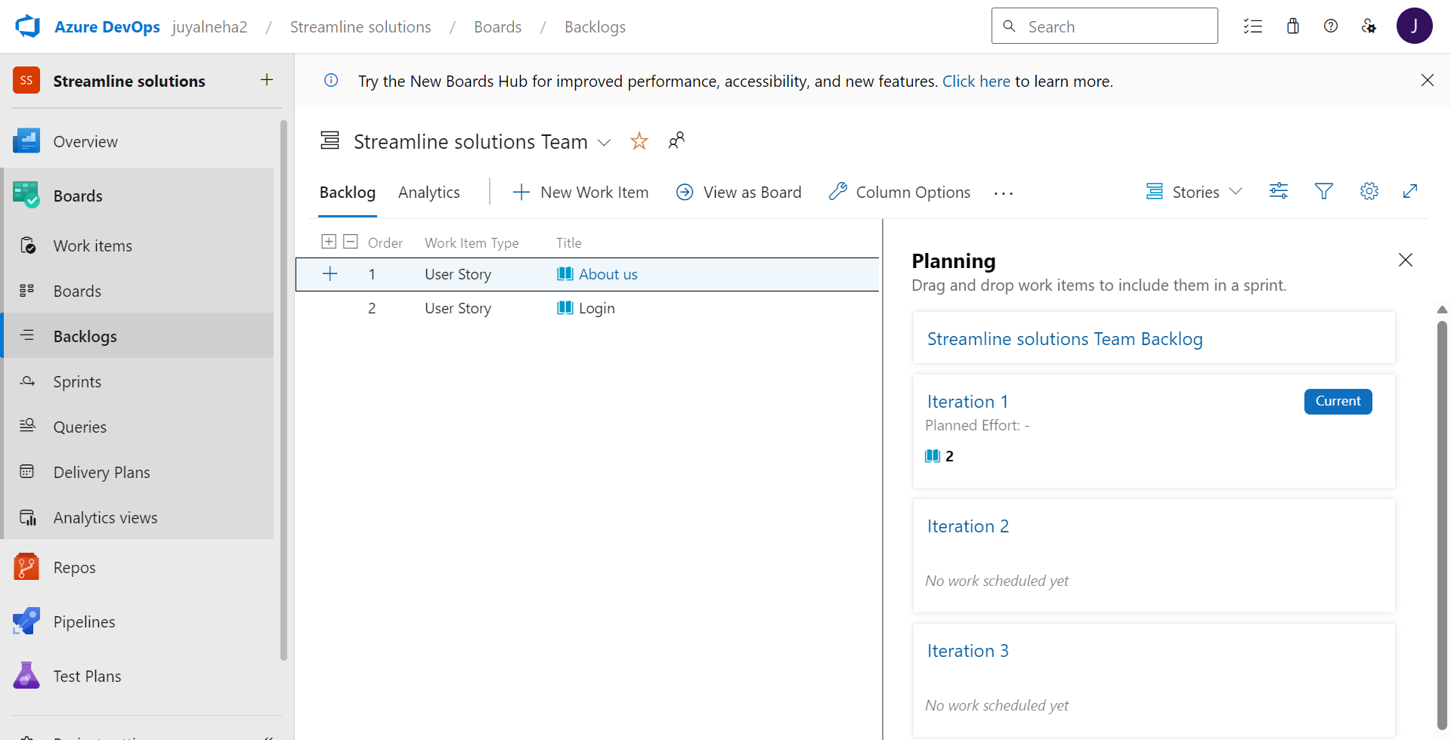

Slide 4
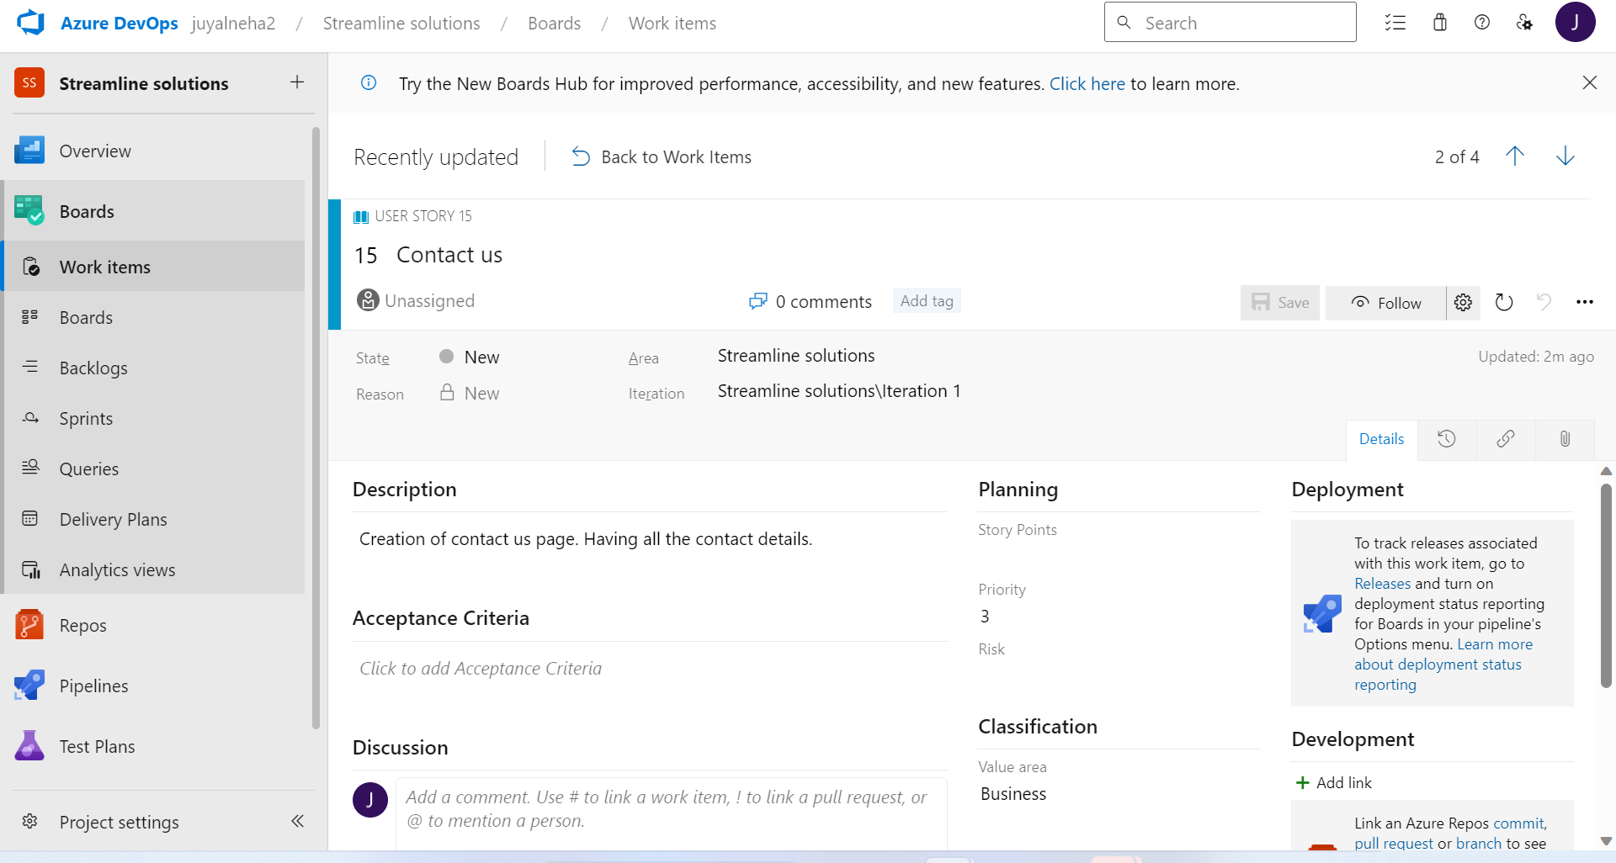

Slide 5
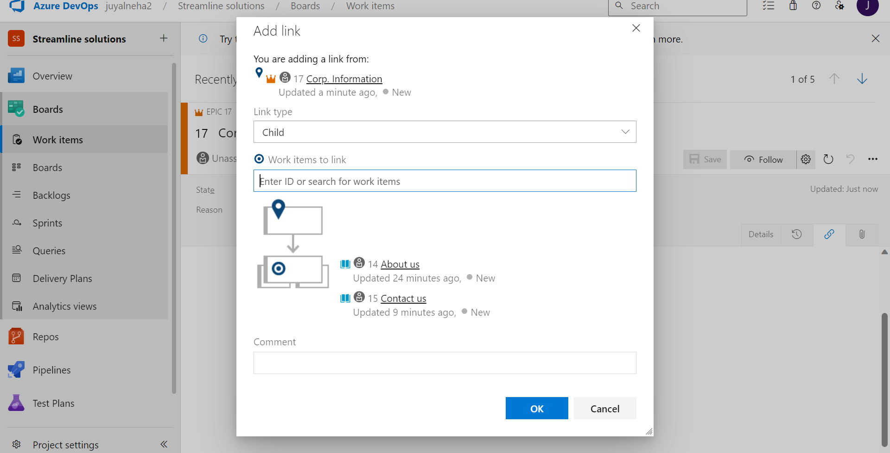

Slide 6
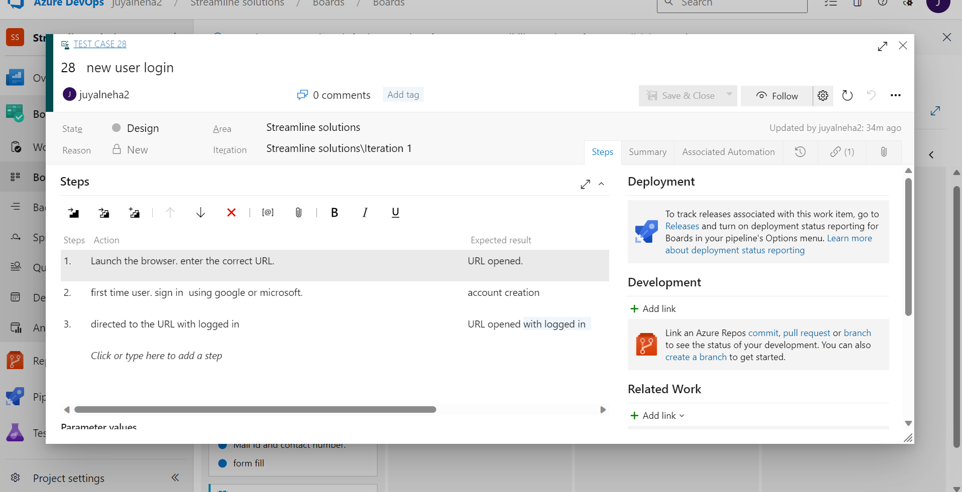

Slide 7
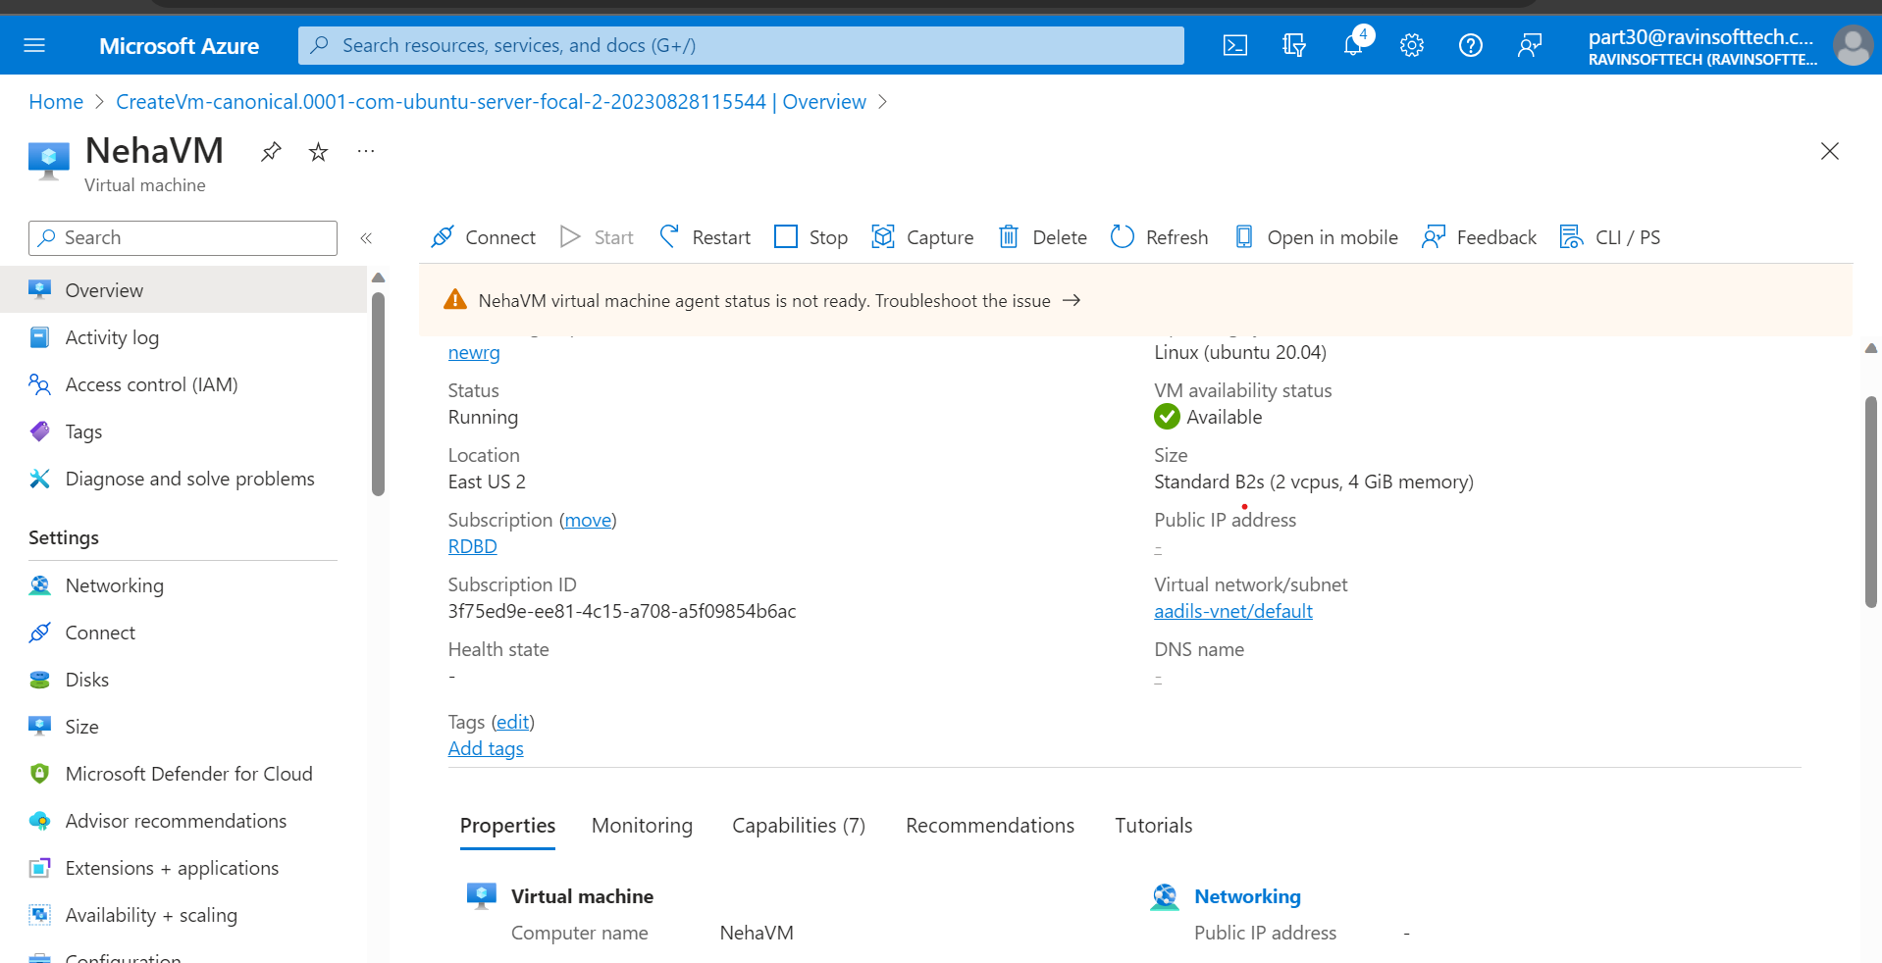

Slide 8
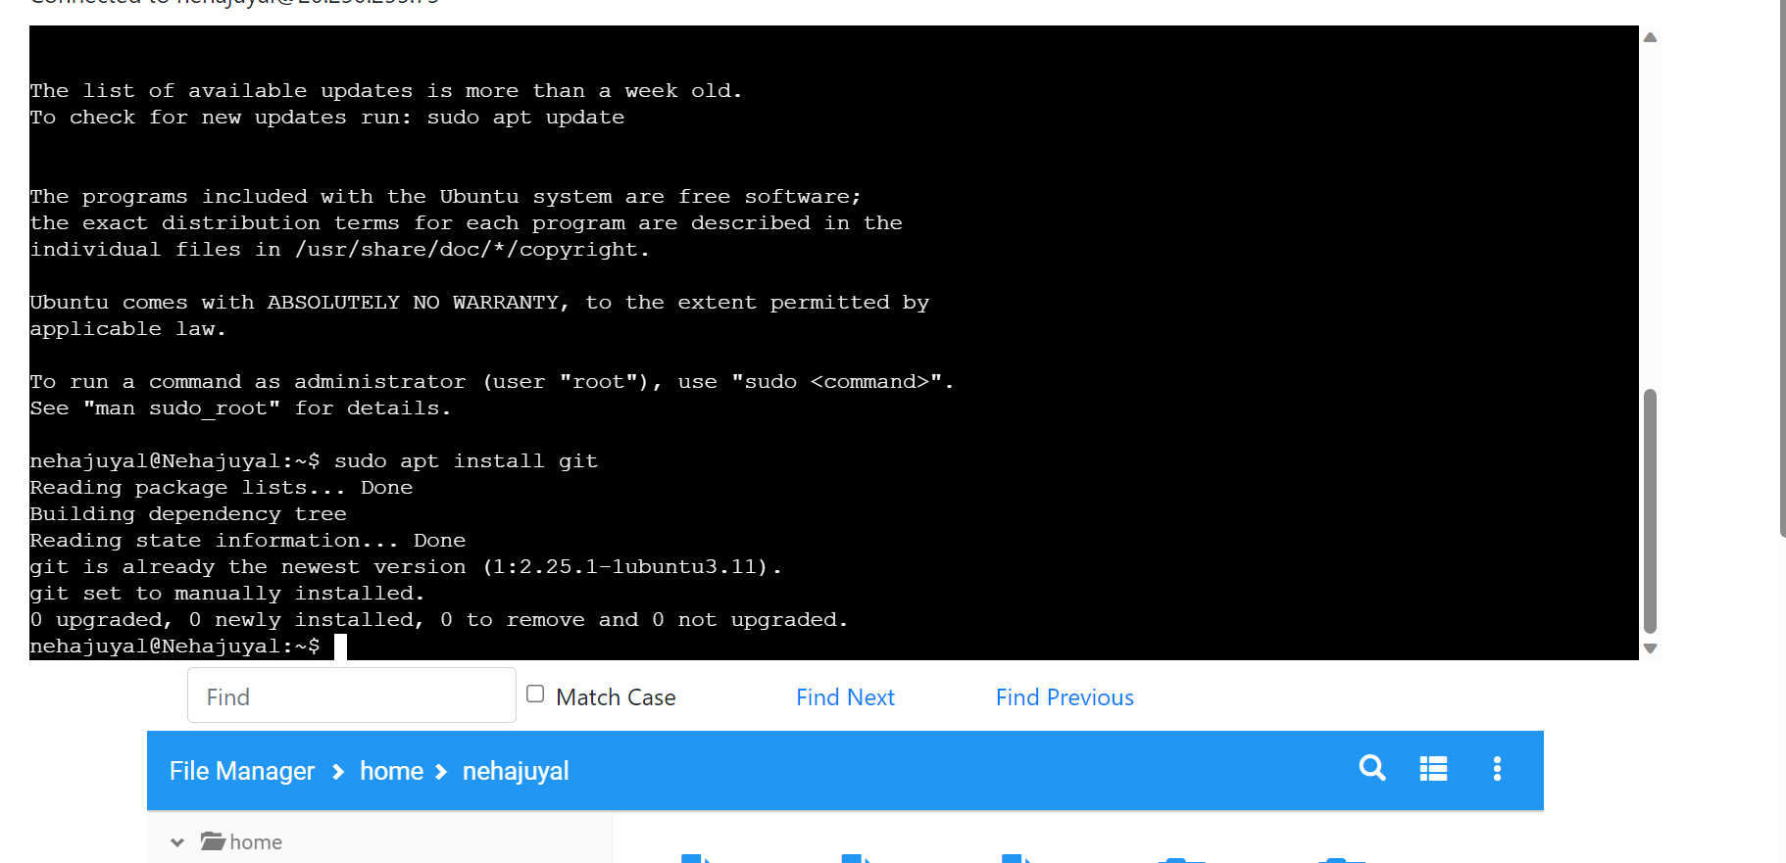

Slide 9
Day – 2 Data Fundamentals
Followings were the learning of Day-2:
Introduction on Data Warehousing
Data Mining introduction
DBMS and its concepts
ER Modelling
Dimensional Modelling
Star Schema
Snowflake Schema
Normalization
De-normalization
Data Integration

Slide 10
Day 3 – Big Data & Azure Fundamentals
Followings were the learning of Day-3:
Introduction on Data Lakes
Data Lake houses
Dimensional Modelling
Various types of big data (Structured, unstructured, semi-structured
Big Data tools
Using SQL queries

Slide 11
Day – 4 Azure SQL
Followings were the learning of Day-4:
DDL, DML, DCL
Creating SQL database on Azure
Selecting, Inserting, Updating and Deleting in SQL
Queries in SQL databases
group by and having,
Using Inner Join for queries
Aggregation

Slide 12
Day – 5 Azure SQL
Followings were the learning of Day-5:
Using Outer Join, inner join , left outer join and right outer join
Giving Assessment
Union
Queries on nested queries
Exceptional queries
Intersection and subqueries
Working with views and functions
Indexes

Slide 13
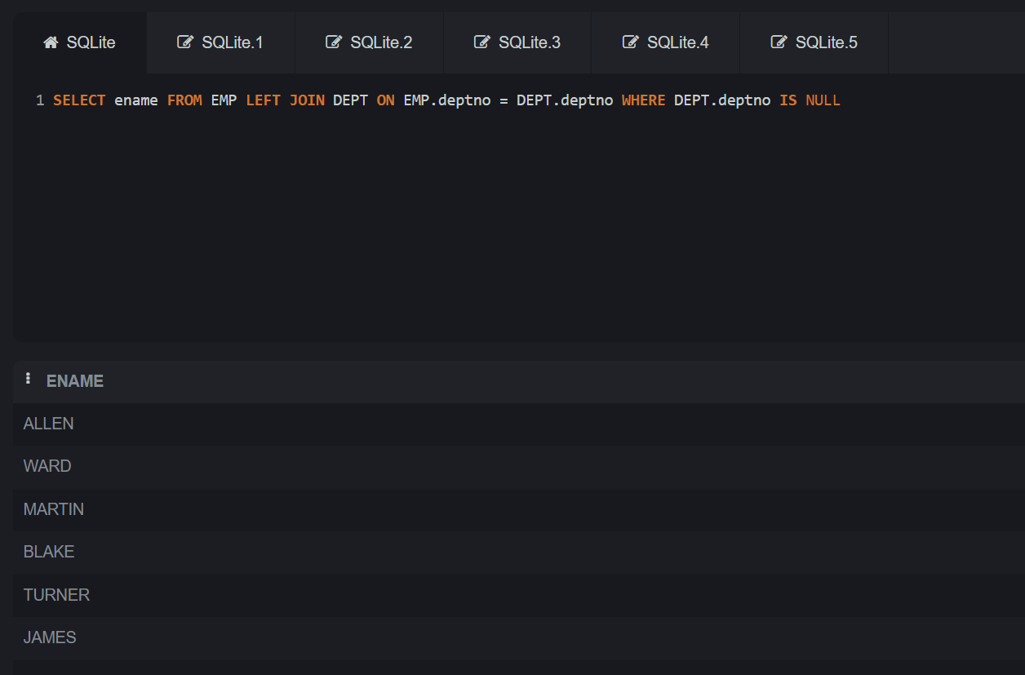

Slide 14
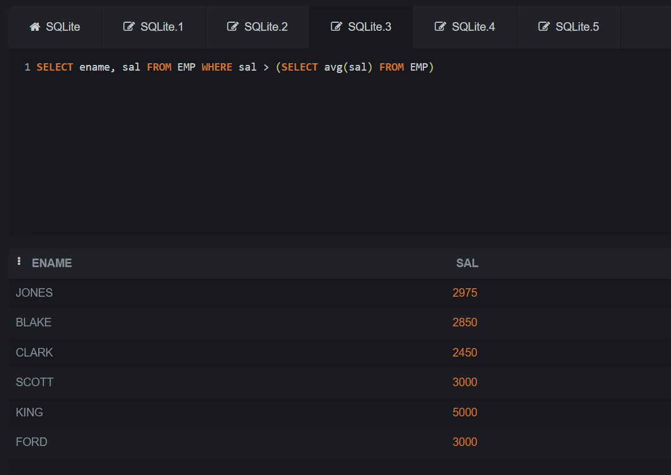

Slide 15
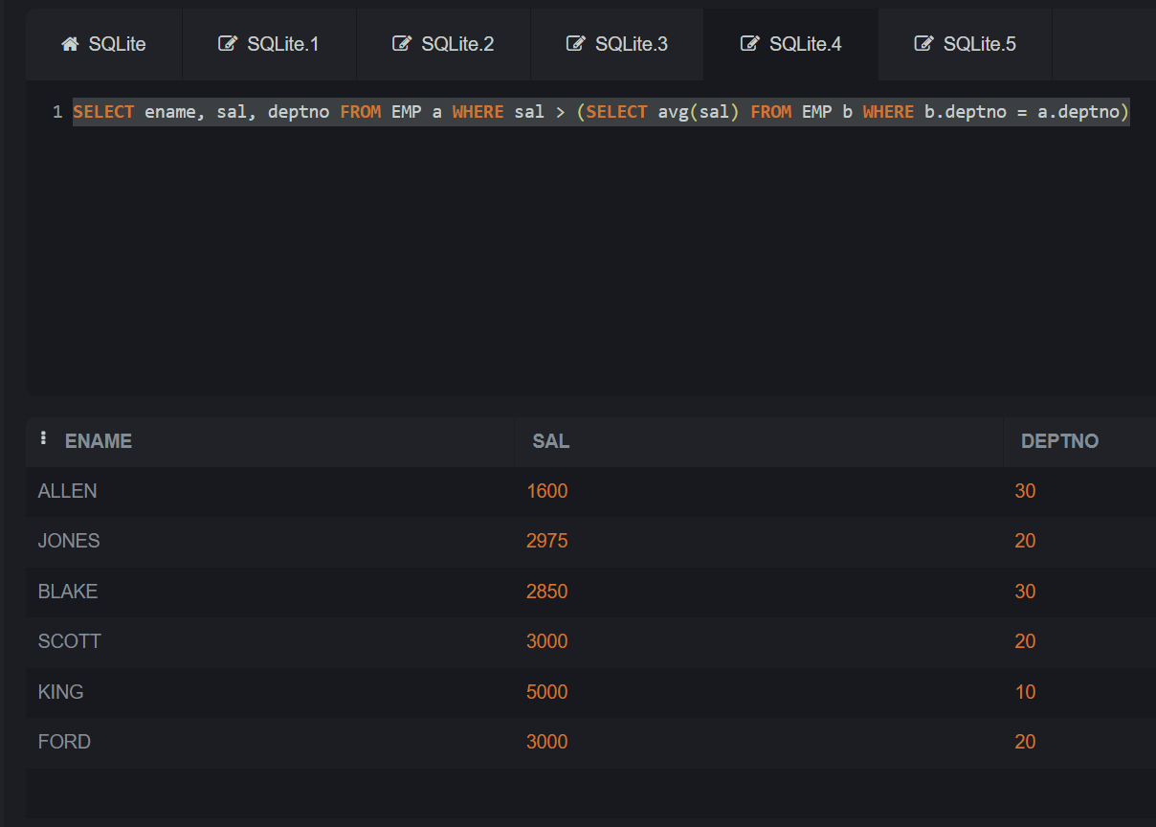

Slide 16
